Slide 1
Import data from
Sql Server
Import data from
Sql Server

Slide 2
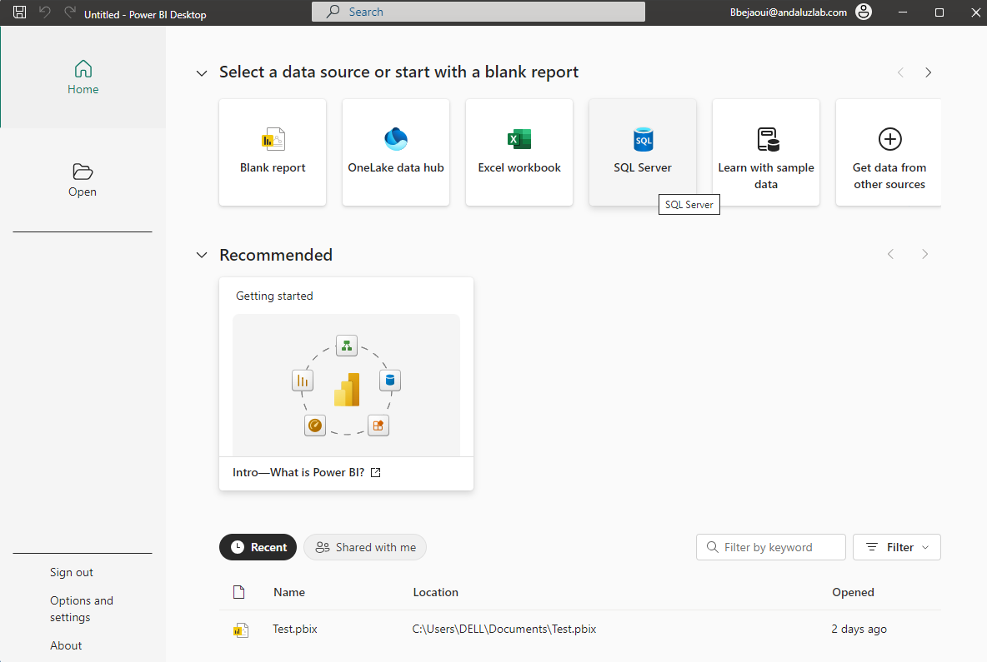
Importing SQL Server Data
Note :
This Lab uses SQL Server
This Lab uses the SQL Server Sales database whose generation script is located in the training resources \resources\Sales model\ sales_database_script.sql
Choose data source from More… menu

Slide 3
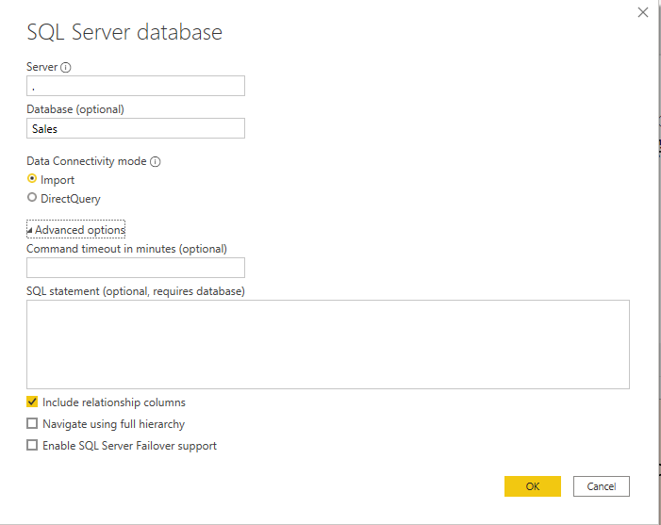
Importing SQL Server Data
Fill in the fields server name, connectivity type and keep the inclusion of relations, for the rest of the parameters we ignore them at this level and click OK
1
Server name
2
Data base name
3
Query statement

Slide 4
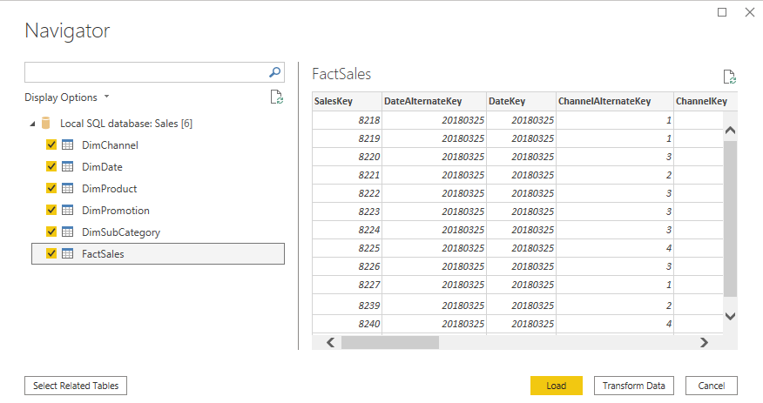
Importing SQL Server Data
Select tables to import

Slide 5
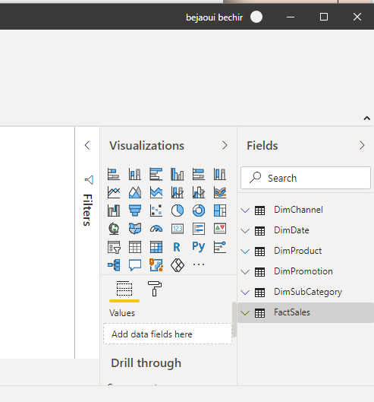
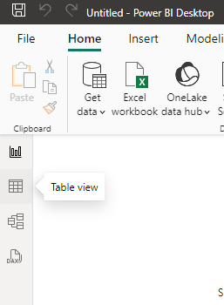
Importing SQL Server Data
Look at Fields pane on the left and explore imported data
2
1

Slide 6
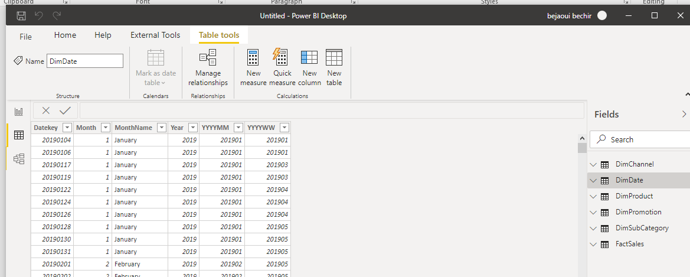
Importing SQL Server Data
Look at Fields pane on the left and explore imported data

Slide 7
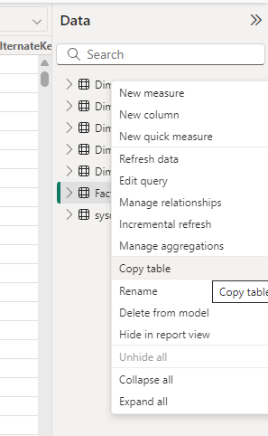
Importing SQL Server Data
Note that at the top menu level, it is possible to
Change the table name
Managing relationships
Create a measure
Create a quick measure with wizard
Create a new calculated column
Create a new calculated table

Slide 8
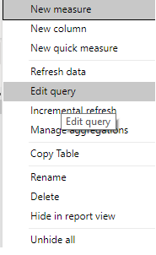
Importing SQL Server Data
Right click on DimDate and click Edit query

Slide 9
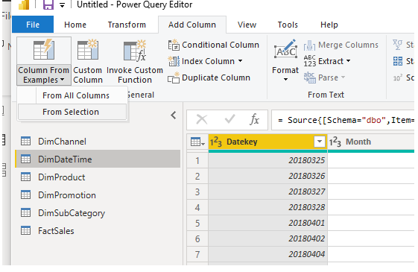
Importing SQL Server Data
Click From Selection of Column From Examples tab Add Column
1
Select Add Column
2
Select Custom Column
3
Select From Selection

Slide 10
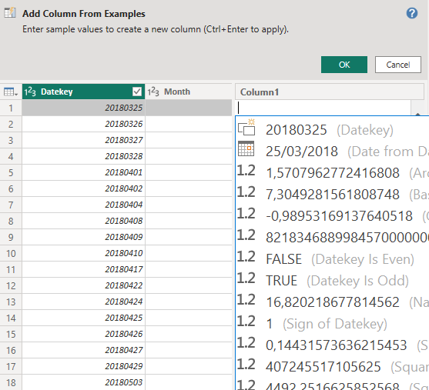
Importing SQL Server Data
Select the date as an example and press CTRL+ENTER and then OK

Slide 11
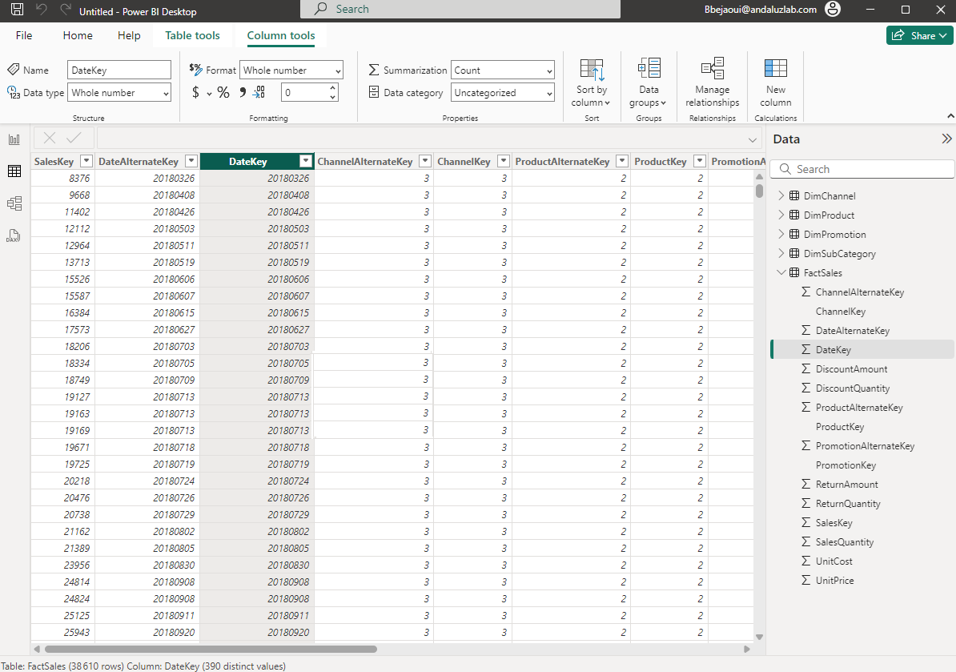
Importing SQL Server Data
It will be possible to use the DateKey of the FactSales to generate the entire DimDate

Slide 12
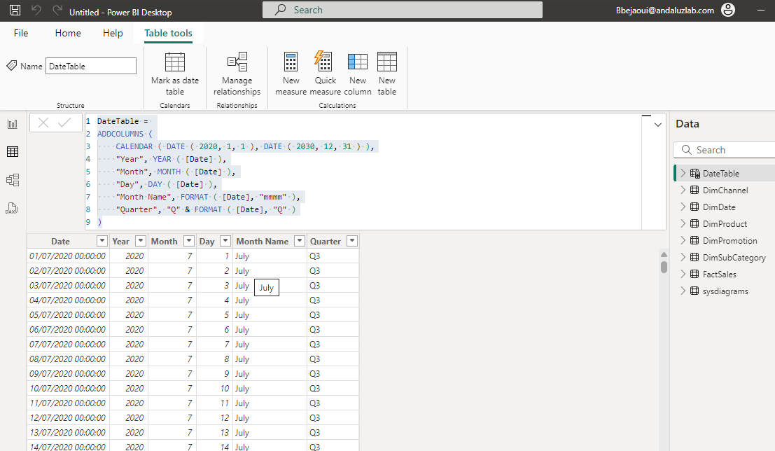
Importing SQL Server Data
It will be possible to recreate the date table having the minimum date and the maximum date at the level of the table imported with DAX for example
1
Select Table tools
2
Select New Table
4
Execute the query
3
Define the query to
generate the data
Notes:
Script to generate Date table:
DateTable = ADDCOLUMNS ( CALENDAR ( DATE ( 2020, 1, 1 ), DATE ( 2030, 12, 31 ) ), "Year", YEAR ( [Date] ), "Month", MONTH ( [Date] ), "Day", DAY ( [Date] ), "Month Name", FORMAT ( [Date], "mmmm" ), "Quarter", "Q" & FORMAT ( [Date], "Q" ) )
Exemple 2:
DimDate =
ADDCOLUMNS (
CALENDAR (
DATE ( MIN ( FactSales[DateKey] ), 1, 1 ),
DATE ( MAX ( FactSales[DateKey] ), 12, 31 )
),
"Year", YEAR ( [Date] ),
"Month", MONTH ( [Date] ),
"Day", DAY ( [Date] ),
"Month Name", FORMAT ( [Date], "mmmm" ),
"Quarter", "Q" & FORMAT ( [Date], "Q" )
)

Slide 13
Importing SQL Server Data
Execute this script to generate the DimDate
DimDate =
ADDCOLUMNS (
CALENDAR (
DATE ( DIVIDE ( MIN ( FactSales[DateKey] ), 10000 ),
MOD ( DIVIDE ( MIN ( FactSales[DateKey] ), 100 ), 100 ),
MOD ( MIN ( FactSales[DateKey] ), 100 )
),
DATE ( DIVIDE ( MAX ( FactSales[DateKey] ), 10000 ),
MOD ( DIVIDE ( MAX ( FactSales[DateKey] ), 100 ), 100 ),
MOD ( MAX ( FactSales[DateKey] ), 100 )
)
),
"DateKey", YEAR ( [Date] ) * 10000 + MONTH ( [Date] ) * 100 + DAY ( [Date] ),"Year", YEAR ( [Date] ),
"Month", MONTH ( [Date] ),
"Day", DAY ( [Date] ),
"Month Name", FORMAT ( [Date], "mmmm" ),
"Quarter", "Q" & FORMAT ( [Date], "Q" )
)

Slide 14
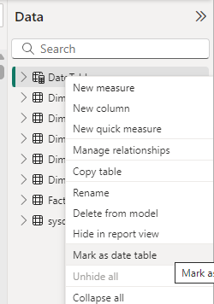
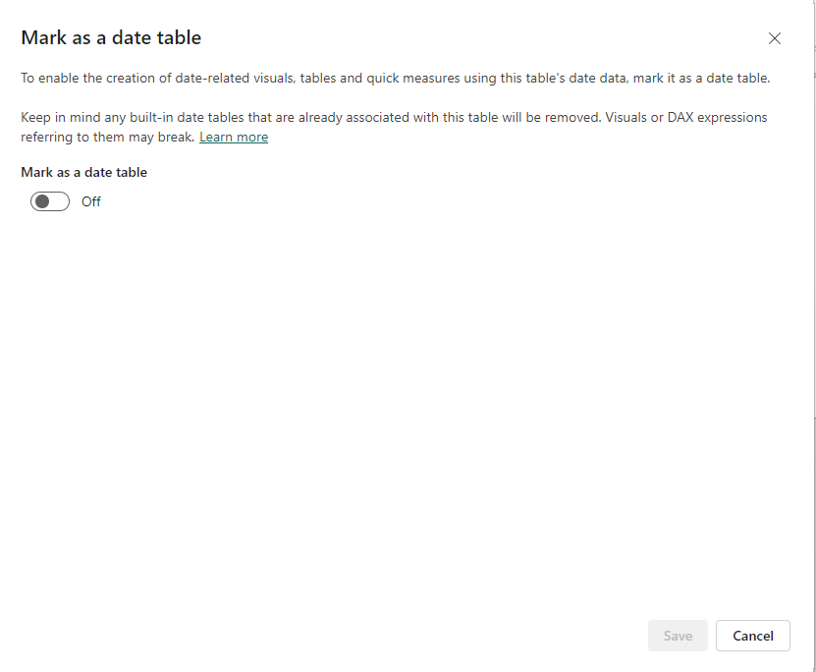
Importing SQL Server Data
Mark the table as Date table, right clicking the table then selecting Mark as date table

Slide 15
Thank you
Thank you

